Slide 1

Classification on SMS Spam Collection Dataset
Chandrashekar Panjhazari CS 522 Data Mining, Hood College cp22@Hood.edu

Slide 2
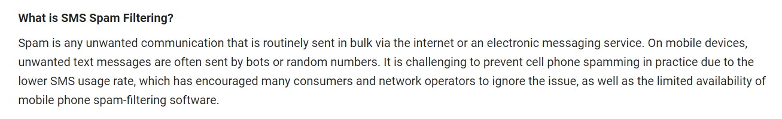

Slide 3
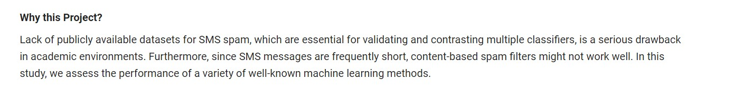

Slide 4
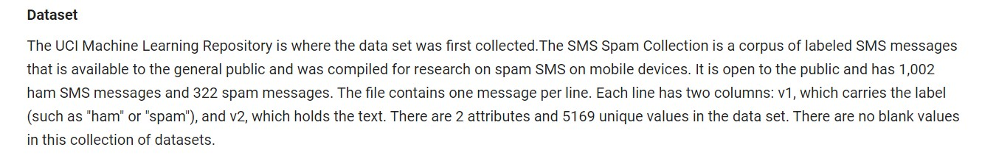

Slide 5
Classifiers:
Naïve Baye’s
Random Forest
KNN
SVM

Slide 6
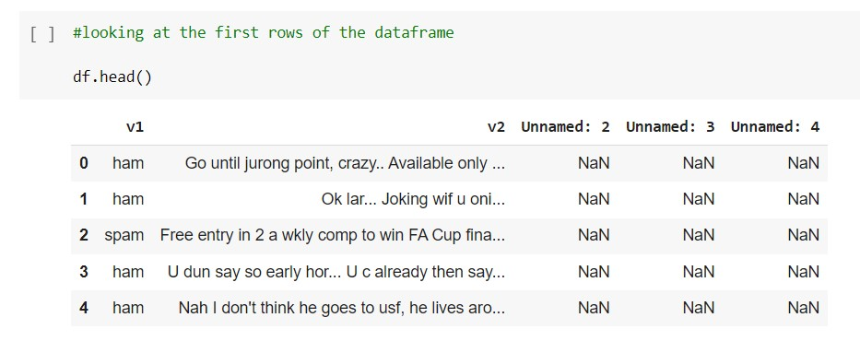

Slide 7
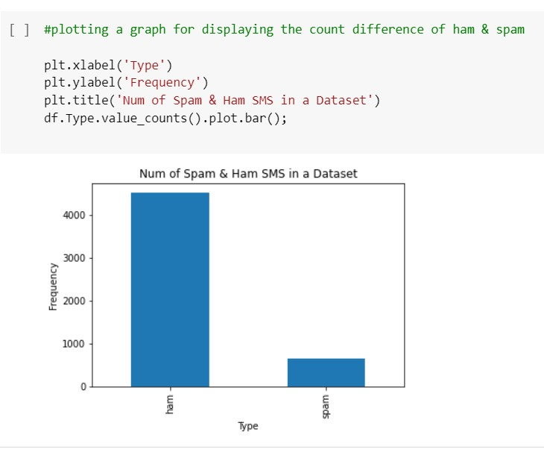

Slide 8
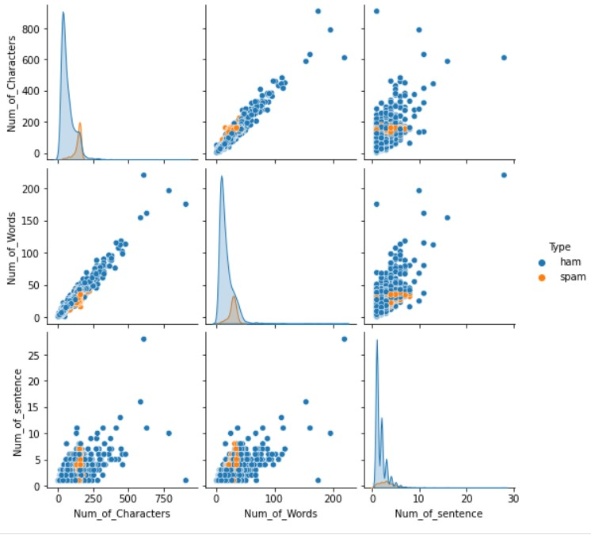

Slide 9
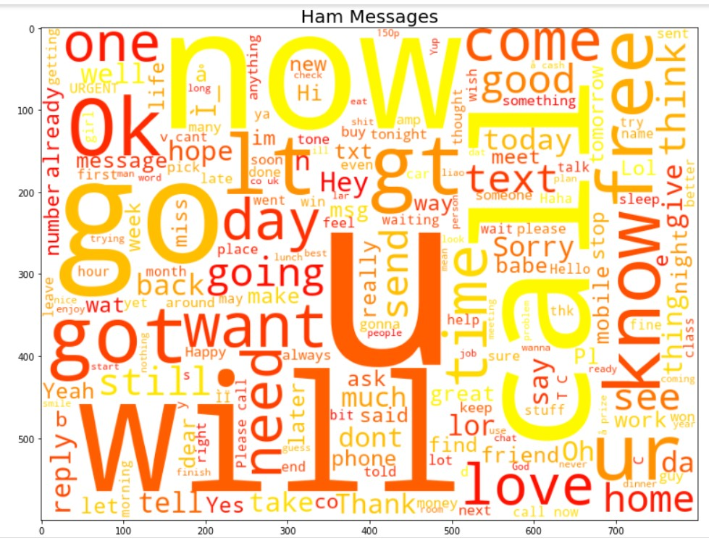

Slide 10
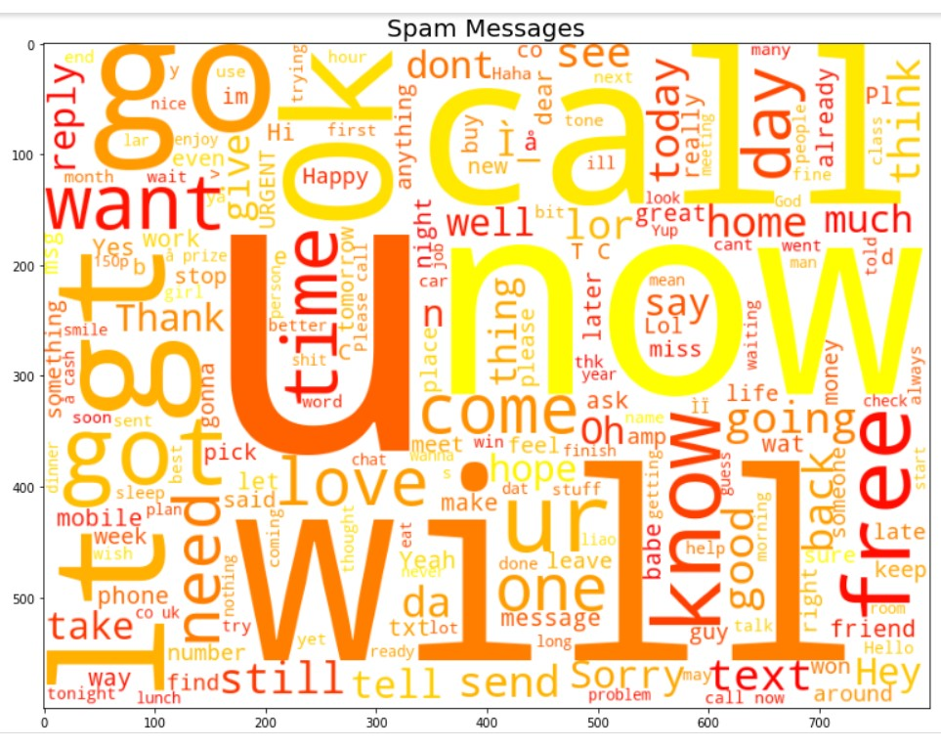

Slide 11
